Slide 1





NextGen Simulation Development Tools: ngen-datastream
Lynker: Jordan laser, Zach wills, Mike Johnson, Justin Singh-Mohudpur, Nels frazier, Austin Raney
Alabama Water Institute: Arpita patel, James Halgren, Josh Cunningham, Shahabul alam, trupesh patel, hari teja jajula, Benjamin Lee
SPRING 2024

Slide 2
Overview
Motivation for building ngen-datastream
Development Roadmap
Conceptual model
Technical breakdown
Usage
Workshop
Future work

Slide 3
motivation
ngen-datastream aims to address these issues
Batteries included while not dogmatic – ngen-datasteam will perform every required step for you, but the user can compute some steps separately, and provide those files to ngen-datastream via the resource directory or command line arguments.
Uses the NextGen In A Box standard run directory.
Metadata – all relevant information about user inputs, code versions, host architecture, etc. so that a NextGen execution can be understood and reproduced.
Infrastructure as Code, Terraform – ngen-datastream can issue NextGen jobs an AWS state machine that use Lambda functions to coordinate NextGen executions in the cloud. This allows users to customize their host to match their compute requirements.
Generates baseling dataset in the cloud
NextGen In A Box made NextGen more accessible to the community, however we still wrestle with a few issues
Uniform data pipeline that abstracts all required steps to run and version a NextGen execution.
Reproducibility
Lack of widely adopted data standard
Scaling from laptop to HPC
Need baseline dataset to evaluate new realizations

Slide 4
Development roadmap
ngen-datastream is already a powerful tool, but is still under development and has not been rigorously tested within the community
We encourage community feedback and questions. If you discover a bug, or would appreciate different functionality, let us know by submitting an issue to the repository
We are here!
Planning
Development
Deployment
Testing
Maintenance
Identifying needs in community
Software architecture decisions
Writing the software
Developer based testing
Releasing software to community
ngen-datastream version 1.0
Continuous Integration Continuous Deployment (CI/CD)
Feedback from community
Add features

Slide 5
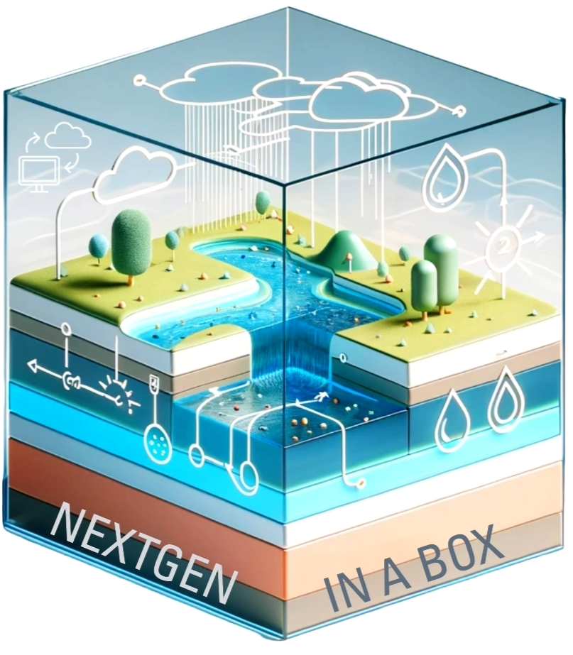
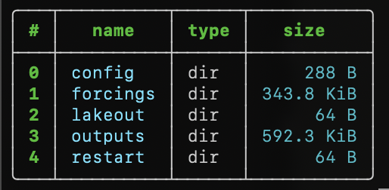
3
Prepare configuration and data inputs
Validation
Versioning
1
2
4
NGEN-DATASTREAM
ngen-datastream refers to the software chain that builds and validates NextGen input packages (ngen-run/), executes NextGen through NextGen In A Box (NGIAB), and versions the entire run for reproducibility.
This enforces a standard folder ngen-run/ which makes validation and versioning possible. A standard run folder also allows for other new tools to easily integrate with NGIAB (e.g., DataPreprocessor).

Slide 6
Prepare configuration and data inputs
1
Required steps to build ngen-run/config and ngen-run/forcings
Hydrofabric
Weights
Forcings
NEXTGEN BMI model configuration
GET
CALC
CALC
CALC
Defines spatial domain
Indices and coverage used to extract catchment averaged forcings
Performs conversion between National Water Model and NextGen forcings formats
Required files for NextGen BMI modules

Slide 7

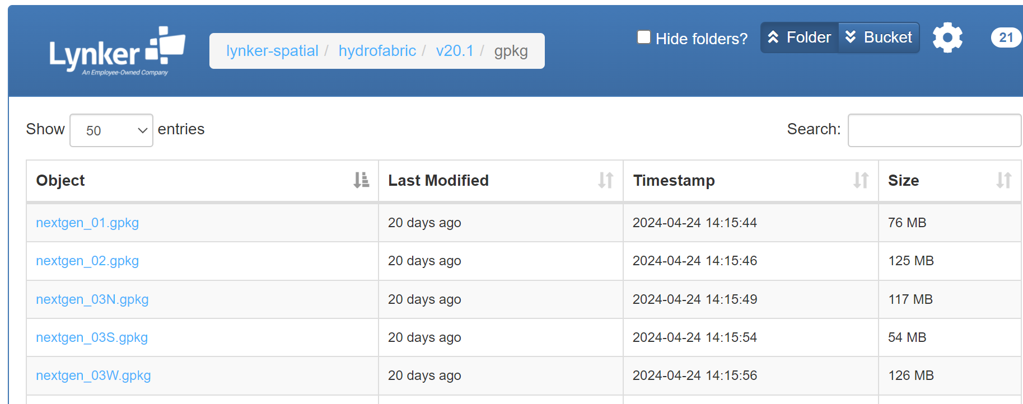
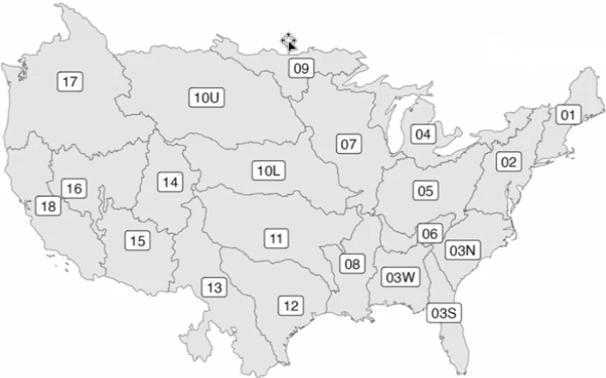
https://www.lynker-spatial.com/#hydrofabric/
Prepare configuration and data inputs
1
Hydrofabric
GET
Defines spatial domain

Slide 8
Prepare configuration and data inputs
1
“What if I want to define my own spatial “domain?
Do you know the catchment id you want to subset with?
Hydrofabric
Yes
No
GET
Use the subsetting options for ngen-datastream!
hfsubset, a tool developed by the hydrofabric team, is integrated into ngen-datastream
Use DataPreprocessor for a user-friendly interface to find your desired domain!
Defines spatial domain

Slide 9
Prepare configuration and data inputs
1
Required steps to build ngen-run/config and ngen-run/forcings
Hydrofabric
Weights
Forcings
NEXTGEN BMI model configuration
GET
CALC
CALC
CALC
Defines spatial domain
Indices and coverage used to extract catchment averaged forcings
Performs conversion between National Water Model and NextGen forcings formats
Required files for NextGen BMI modules

Slide 10

Index: 27463
Coverage: 75%
Prepare configuration and data inputs
1
Index: 27461
Coverage: 25%
Hydrofabric
Weights
GET
CALC
NWM
Defines spatial domain
Indices and coverage used to extract catchment averaged forcings
NGEN

Slide 11
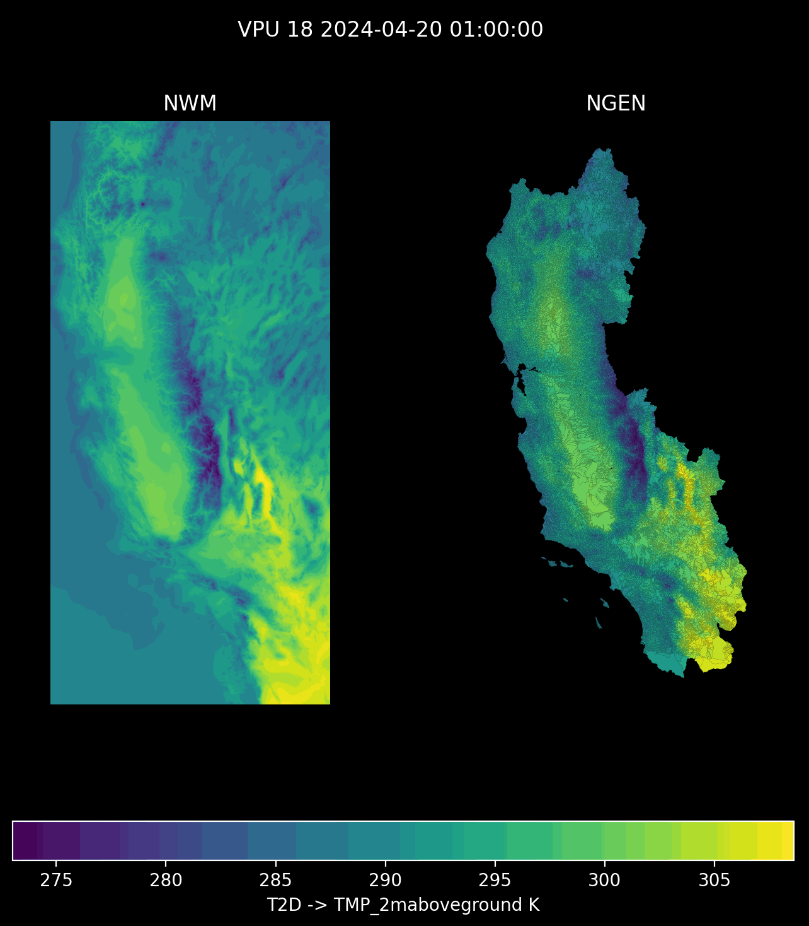
Prepare configuration and data inputs
1
Hydrofabric
Weights
Forcings
GET
CALC
CALC
Defines spatial domain
Indices and coverage used to extract catchment averaged forcings
Performs conversion between National Water Model and NextGen forcings formats

Slide 12
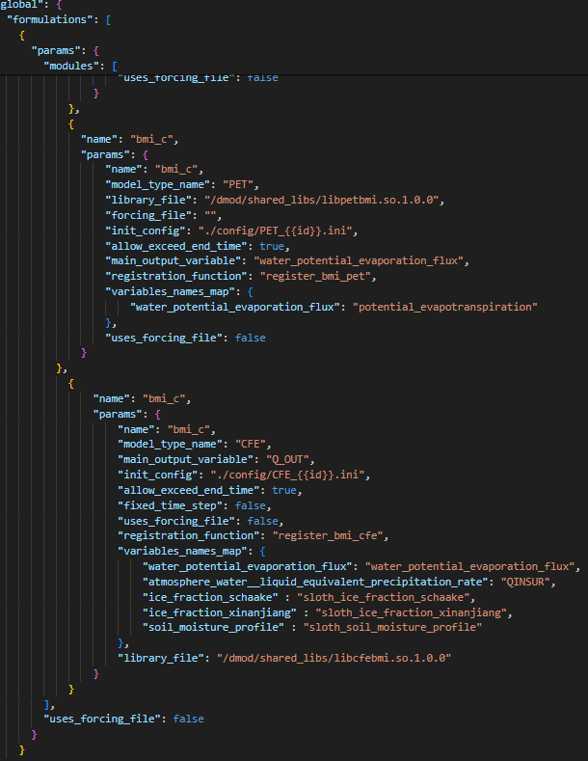
Prepare configuration and data inputs
1
Automatic BMI module detection from realization file
Hydrofabric
Weights
Forcings
NEXTGEN BMI model configuration
GET
CALC
CALC
CALC
Defines spatial domain
Indices and coverage used to extract catchment averaged forcings
Performs conversion between National Water Model and NextGen forcings formats
Required files for NextGen BMI modules

Slide 13
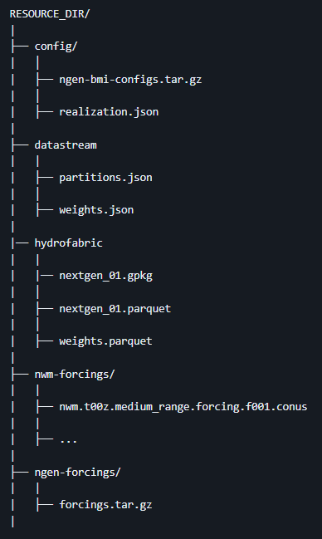
Weights and BMI model configuration generation are identical for a given spatial domain, hydrofabric version, and realization, meaning these files can often be reused. In addition, forcings can be reused if simulation start and end are static. Recycling these files via the resource directory can be thought of running ngen-datastream in “lite” mode.
Prepare configuration and data inputs
1
Hydrofabric
Weights
Forcings
NEXTGEN BMI model configuration
GET
CALC
CALC
CALC
Defines spatial domain
Indices and coverage used to extract catchment averaged forcings
Performs conversion between National Water Model and NextGen forcings formats
Required files for NextGen BMI modules
*SAVES MONEY*
https://github.com/CIROH-UA/ngen-datastream/tree/main?tab=readme-ov-file#resource_dir-datastream-resources

Slide 14
3
Prepare configuration and data inputs
Validation
Versioning
1
2
4
NGEN-DATASTREAM
ngen-datastream refers to the software chain that builds and validates NEXTGEN input packages (ngen-run/), executes NEXTGEN through NEXTGEN In A Box (NGIAB), and versions the entire run for reproducibility.
This enforces a standard folder ngen-run/ which makes validation and versioning possible. A standard run folder also allows for other new tools to easily integrate with NGIAB (e.g., DataPreprocessor).

Slide 15
NEXTGEN Water Modeling Framework Datastream Conceptual Model Breakdown
TLDR: The value of the validation step is to notify the user of any errors in the NEXTGEN run package before beginning the execution
Validation
2
https://github.com/CIROH-UA/ngen-datastream?tab=readme-ov-file#ngen-run
https://github.com/CIROH-UA/ngen-datastream/tree/main/python#run_validatorpy
https://github.com/NOAA-OWP/ngen-cal/tree/master
Realization
Forcings
BMI configuration
Ensures the user has supplied a valid realization file to configure NEXTGEN
Ensures a forcing file exists for each catchment in the hydrofabric and for each time step specified in the realization
Ensures all BMI model configuration files exist.
Required for

Slide 16
3
Prepare configuration and data inputs
Validation
Versioning
1
2
4
NGEN-DATASTREAM
ngen-datastream refers to the software chain that builds and validates NEXTGEN input packages (ngen-run/), executes NEXTGEN through NEXTGEN In A Box (NGIAB), and versions the entire run for reproducibility.
This enforces a standard folder ngen-run/ which makes validation and versioning possible. A standard run folder also allows for other new tools to easily integrate with NGIAB (e.g., DataPreprocessor).

Slide 17
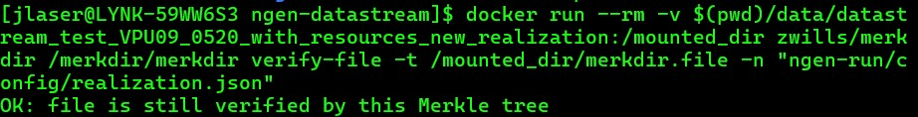
Merkle Tree based hashing algorithm
“Root” hash allows for quickly identifying if two ngen-run directories are different.
Ability to query whether some file is a part of the tree represented by the root hash
Ability to compare files without opening them
Versioning
4
4

Slide 18
Technical breakdown
Fundamentally, ngen-datastream is a linux shell script that automates the entire process laid out in the conceptual model. Largely, this is accomplished by moving data between docker containers that handle the necessary computations in pre-configured environments.
Portability and scalability.

Slide 19
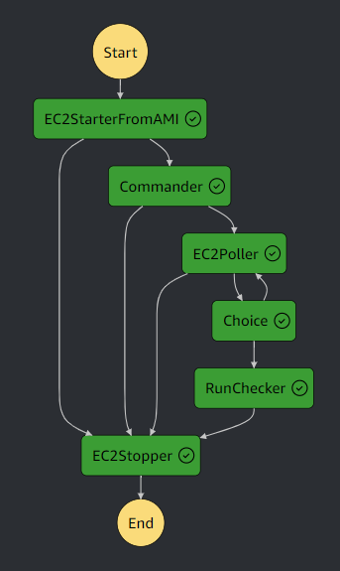
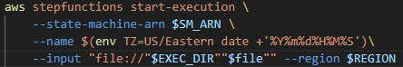
customize nextgen simulation resources
ngen-datastream allows users to submit NextGen simulation jobs to cloud-based hosts in Amazon Web Services (AWS)
Users submit jobs via a customizable execution json to a generalizable AWS state machine that manages job execution
Customizable parameters in the execution json include:
Instance Type
Image Id
Number of instances
Volume Size
Region
Security Groups / Instance profile (IAM)
Commands

Slide 20
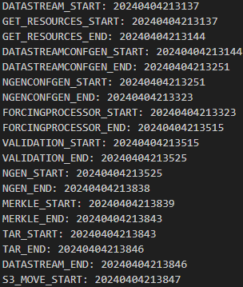
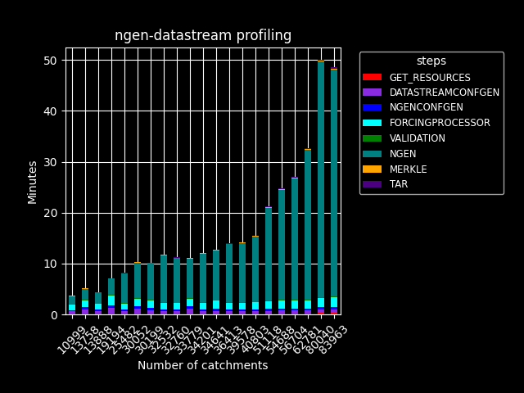
scale to the cloud
datastream-metadata/profile.txt
Split VPU daily run - An application of the ngen-datastream AWS state machine
24-hour CONUS NextGen simulation scheduled each day with AWS EventBridge
22 individual ec2 instances, 1 for forcingprocessor , 21 simultaneously processing for each VPU
Runtime determined by the runtime of the largest VPU.
Takeaways:
Terraform allows for quick building of complex AWS infrastructure
Allows users to access HPC resources
Highly configurable execution file allows users to finely tune resources to their ngen executions

Slide 21
usage
ngen-datastream is a powerful tool designed to utilize compute resources to their maximum extent.
In general, ngen-datastream memory footprint scales with
Number of catchments (size of the spatial domain)
Number of time steps (Simulation duration / output_interval)
If a crash is experienced, either increase the host resources or decrease one or both above dimensions
Linux commands to monitor resources
Watch memory usage -> free –h –s2
Watch processes/cpu usage -> top
Check available processes -> nprocs
https://github.com/CIROH-UA/ngen-datastream/blob/main/USAGE.md

Slide 22
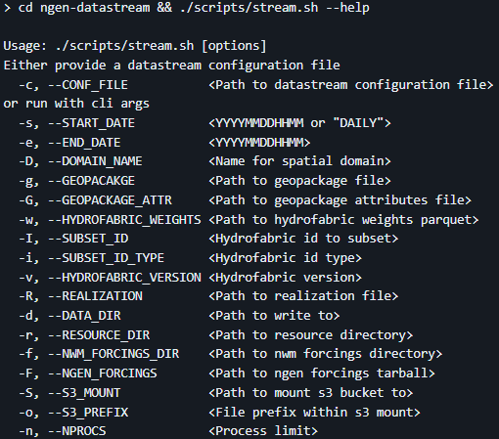
Workshop: options
simulation start and end
spatial domain
NextGen configuration
ngen-datasteam “lite”
RUN options
AWS s3 mount

Slide 23
workshop
https://github.com/CIROH-UA/ngen-datastream/blob/main/docs/CIROH_devcon_2024/workshop.md

Slide 24
Take-aways
Collaborative process! Feel free to contact me with questions
Let

Slide 25
Future work
CI/CD
Feedback/Collaboration with community
Begin the science!
Find regional improvements to NextGen simulations
Expand modules ngen-datastream is aware of

Slide 26
Terms
Catchment – geographic area characterized by a single location, a nexus, where all precipitation in the area runs off through. A drainage basin.
Nexus – the singular point where water flows into or out of a catchment. Often a point along a river.
Subsetting – To reduce a large geopackage (many catchments) down to a smaller geopackage (fewer catchments) . In effect, this is choosing the domain over which ngen will run.
Hashing – SHA256 algorithm applied to files to generate a unique id for a file. Useful for preserving and distinguishing unique inputs.
Validation – Ensuring the ngen input directory data_dir has been constructed properly. Properly meaning that NextGen will not crash and will generate output data.

Slide 27
Acronyms
NWM – National Water Model
NGIAB – Next Generation National Water Model in a Box
NGEN/NEXTGEN - Next Generation National Water Model
IaC – Infrastructure as code
VPU – Vector Processing Unit
CFE – Conceptual Function Equivalent
PET – Potential Evapotranspiration
NOM – NOAA-OWP-Modular
OWP – Office of water prediction
BMI – Basic Model Interface

Slide 28
links
DATASTREAM https://github.com/CIROH-UA/ngen-datastream/tree/main
FORCINGPROCESSOR https://github.com/CIROH-UA/ngen-datastream/tree/main/forcingprocessor
REALIZATION GENERATION AND NGEN-RUN FOLDER VALIDATION https://github.com/NOAA-OWP/ngen-cal
HYDROFABRIC SUBSETTING https://github.com/LynkerIntel/hfsubset
HASHING/VERSIONING https://github.com/aaraney/ht
NGIAB https://github.com/CIROH-UA/NGIAB-CloudInfra
https://docs.ciroh.org/
https://docs.ciroh.org/docs/products/tools/nextgeninabox/ngiab-intro
https://github.com/NOAA-OWP/ngen/wiki
https://mikejohnson51.github.io/hyAggregate/
https://ciroh.ua.edu/

